Slide 1
TripMate
Presented:
By Yuvraj Pandey

Slide 2
Introduction
Tripmate is a travel planning and management application designed to help users:
Create and organize trips
Add destinations and itineraries
Track expenses
View trip details anytime
Provide analytics (for admin)

Slide 3
Purpose of the Project
Simplify travel planning
Centralize trip information
Reduce manual tracking
Provide a smooth mobile and web experience

Slide 4
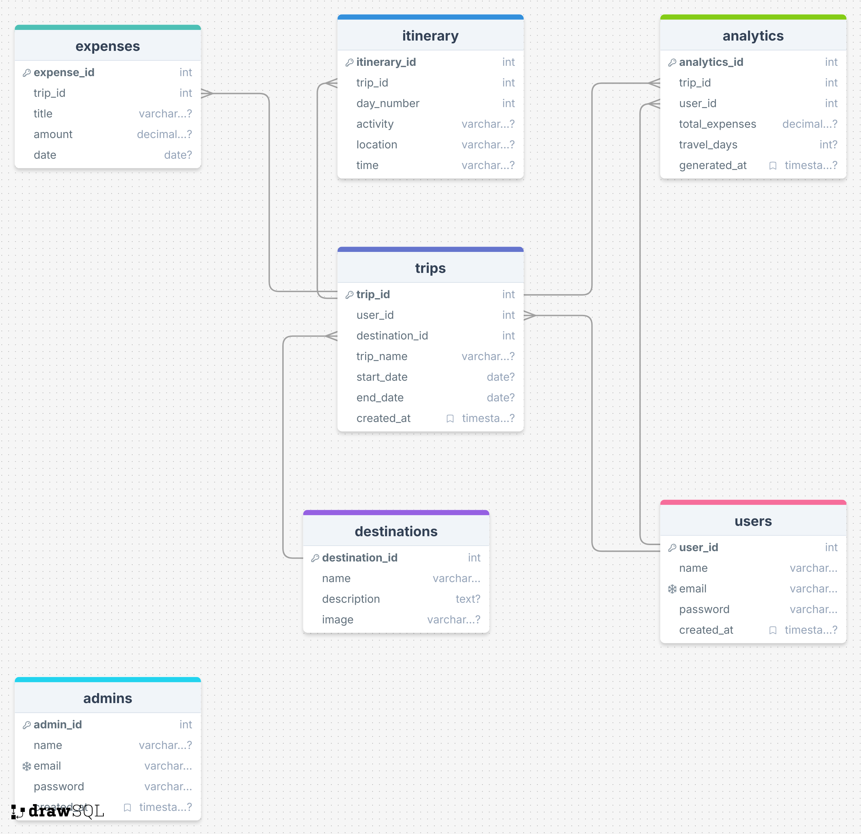
Schema Diagram
Notes:
Schema: drawSQL

Slide 5
System Overview
Core Features Planned:
Trip creation & viewing
Itinerary & destination management
Expense tracking
User accounts
Admin dashboard & analytics
Secure authentication
Cross-platform: Web + Mobile (React Native + Next.js)
Notes:
Firebase
App: React Native
Web: Next.js

Slide 6
Project Completed
React Prototype (Web Version)
A working prototype has been built using React.
Completed Features
Trip Creation
Users can create a new trip by entering details like title, date, destination.
Trip Viewing
Users can view all created trips in a clean UI

Slide 7
Prototype Highlights
Component-based React architecture
State management using hooks
User-friendly and minimal UI
Prototype reflects real TripMate workflow

Slide 8
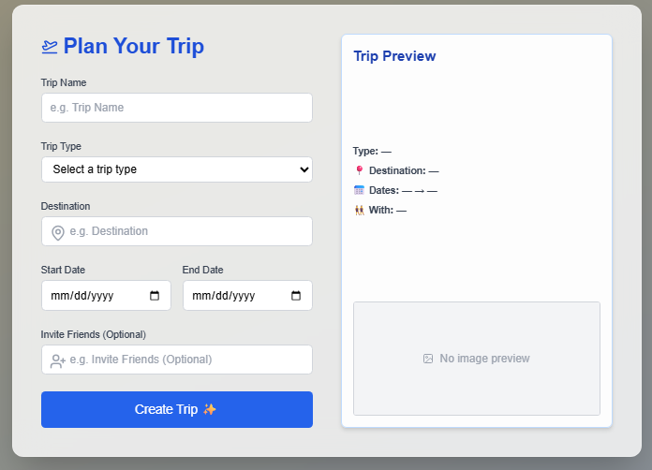
Prototype Demo Screens
Fig: Trip Creation Form

Slide 9
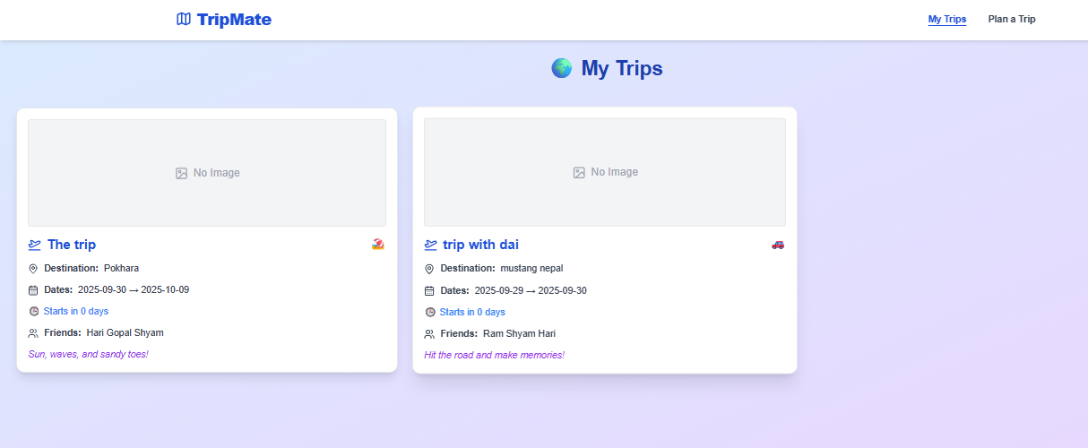
Prototype Demo Screens
Fig: Trip List Page

Slide 10
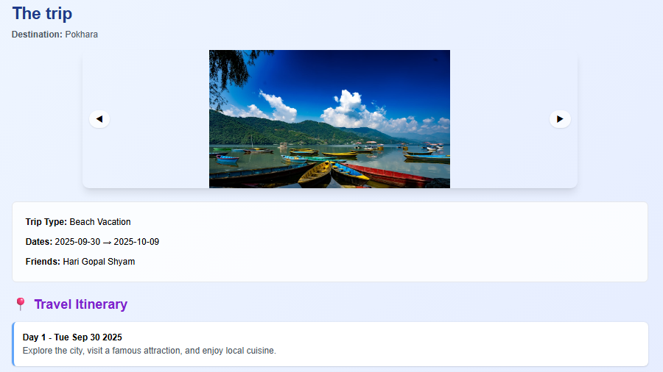
Prototype Demo Screens
Fig: Trip Details Page

Slide 11
Remaining Works
Features Yet to Develop
Itinerary & destination management
Expense tracking module
Authentication (User/ Admin/ Role-based)
Analytics dashboard for admin
Mobile app with React Native (shared logic)
Database integration (Firebase)

Slide 12
Problems Faced
Technical Challenges
Difficulty integrating frontend with backend
Deciding between Next.js & React Native for cross-platform
State management complexity
Designing a scalable database schema
Managing roles (Admin, User)
Development Challenges
Time constraints between UI & backend
Maintaining folder structure consistency
Version control conflicts (Git branching)
Research Challenges
Evaluating best tech stack for both mobile & stack
Understanding travel-related analytics requirements.

Slide 13
Contributions of GitHub
Version control- Maintained history of all code changes

